Slide 1
TN Police Hackathon
SLICING AND SPLICING VOIP TRAFFIC
TEAM NAME: NETWORK SHARKS

Slide 2
Team Members(Skills sets)
Alby Shinoj
Network Security, Infosec
https://www.linkedin.com/in/albyshinoj/
Gifton Paul Immanuel
Scripting, Network Programming
https://www.linkedin.com/in/gifton-paul-immanuel-3831211ab/
Steeve P P
Data Science, Network Programming
https://www.linkedin.com/in/steeve-p-p-87a998249/
Jeslin Hashly
Open-Source Tools
https://www.linkedin.com/in/jeslinhashly/

Slide 3
Introduction
Application software to extract important information from VoIP traffic .
IP addresses -(geolocation)
Talkers involved
Decoded audio files
Time/Duration of calls

Slide 4
Problem
PROBLEM STATEMENT: VoIP/Telegram Message Tracking
PROBLEM IDENTIFIED: Develop methods to extract relevant information from VoIP/Telegram and assist law enforcement agencies in criminal investigations.

Slide 5
Methodology
The procedure of the software written in python, which have functions to return and display the useful information in either readable tabular format and a chart representation.
These include functions like:
Converting packets to raw audio
Raw audio to wav format [using sox]
IP_communication details
Duration of the call
Packet composition chart
etc.,
These can be carried out in a GUI application, which uses customtkinter for its UI and pyshark for analyzing the data.
And for telegram, we can make the victim click our generated IP logger that would also redirect to a new site rather than crashing.

Slide 6
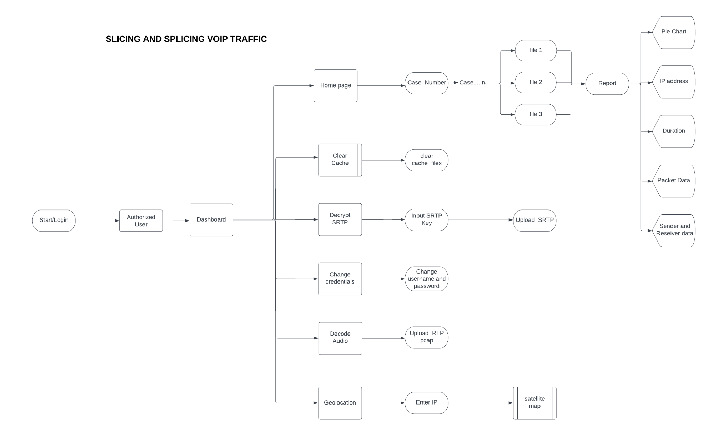
Process Flow

Slide 7
Innovation
Development of a GUI software that would parse through the packets and return IP addresses involved, duration of the call, and percentage of packets, decrypt SRTP and also would decode the packets into a raw audio file which would be further converted to wav format. The report will be generated in a PDF format which would help the department for easy and deep packet analysis. Telegram’s users’ IP addresses can be found through wireshark capture if their setting is favourable. From this IP we find the location, ISP details etc.

Slide 8
Proof of Concept
Economically good
Additional features
Feasibility
The subscription to enterprise software and applications for analysis can be avoided by using this Open source GUI software.
The additional features include converting the raw audio file into a wav file. Generating the report in the form of PDF. And also having a section for exact geolocation,
For the smooth running of this software, it is recommended to have it up and running in a Linux device with good CPU and a good internet connection. And the dependencies are not so hard to install..

Slide 9
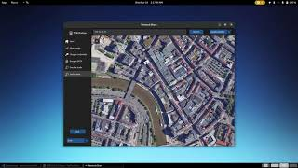
Demo(VoIP analyzer and decrypted tool)

Slide 10
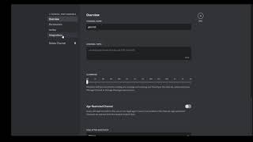
Demo(IP-Logger)

Slide 11
Conclusion
Network Shark can come in handy for a Network Investigation team to investigate a capture and trying to get useful data from it for further analysis and for seeing and analyse their cases through the generated PDF reports.
IP logger can be used to trick the user into clicking the link, which would get us their location details, ISP details and all useful information.

